Slide 1
Computer Architecture and Organization

Slide 2
Module -1
Introduction and overview of computer architecture
Introduction to computer systems
Over view of organization and architecture
Functional components of a computer
Registers and register files
Interconnection of components
Organization of Von Neumann machine
Harvard architecture
Performance of processor

Slide 3
Why this subject?
To acquire some understanding and appreciation of a computer systems functional components, their characteristics, performance and interactions
Need to understand computer architecture in order to structure a program so that it runs more efficiently on a real machine
In selecting a system to use, they should be able to understand the trade of among various components such as CPU clock speed vs memory

Slide 4
Module 1 Introduction and Overview of Computer Architecture
Introduction to Computer Systems
A computer is an electronic data processing machine that accepts data and instructions through input unit (or from memory) and processes data as per the instruction, to get desired output.
A computer system is a complex system consists of both hardware and software.

Slide 5
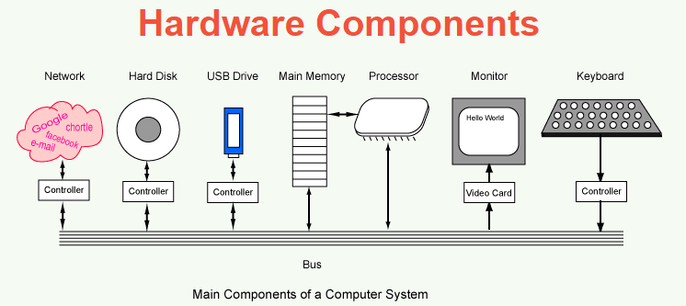
Hardware and Software
The hardware components of a computer system are the electronic and mechanical parts
The software components of a computer system are the data and the computer programs.

Slide 6
Computer is a digital device, which works on two levels of signal: High or Low
High level signal (5v or 12v) and low level signal (0v)
To make it convenient, 0v represented by L (Low) or 0
1v represented by H(High) or 1
All the functionalities of the computer system are represented with 0 and 1
Binary number system is used to represent information and manipulation of information in computer

Slide 7
Overview of Computer Organization and Architecture
Organization
Design of the components and functional blocks using which computers are built
Analogy: Civil Engineer task during building construction (cement, bricks, iron rods and other building materials during construction)
Architecture
How to integrate the components to build a computer system to achieve a desired level of performance
Analogy: Architect task during the planning of the building (overall layout, floor plan, etc.)

Slide 8
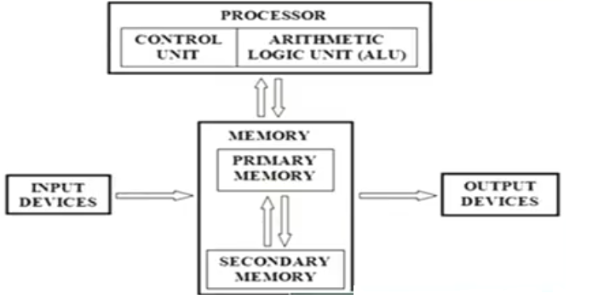
Functional Components of a Computer

Slide 9
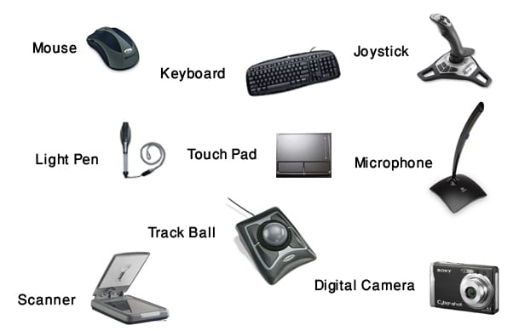
Input Unit

Slide 10
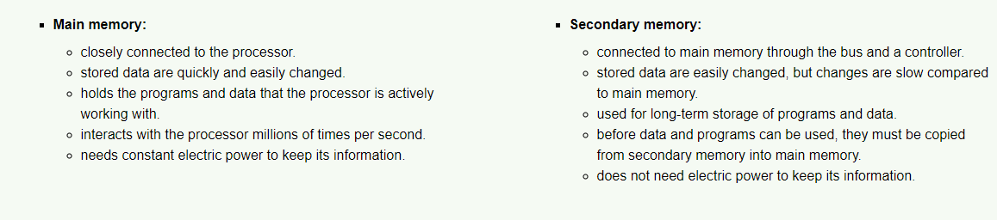
Memory
Physical device to store programs or data
Two types: Main memory (Physical memory) and
Secondary memory
Memory vs storage
Main memory vs Secondary memory

Slide 11
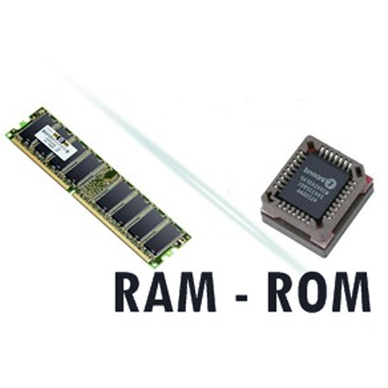
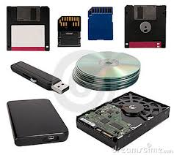
Main memory vs Secondary memory

Slide 12
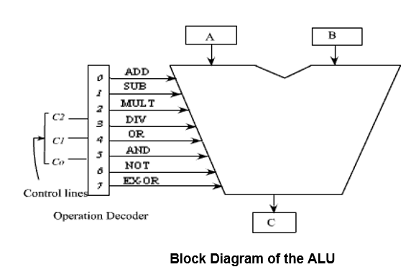
Central Processing Unit (CPU)
Arithmetic and Logic Unit (ALU)
Most computer operations are performed at ALU
Example

Slide 13
Control Unit
Operations of all the units are coordinated by control unit
Sends control signal to all the units
Timing signals that govern the data transfer, are generated by control circuits
Timing signals are signals that determine when a given action takes place

Slide 14
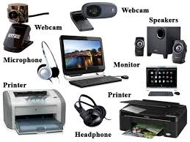
Output Unit

Slide 15
Evolution of computer system
The beginning of computing – Abacus 3000 BC
Calculating tool that was in use centuries before the adoption of the written modern numeral system
Still widely used by traders, merchants and clerks in Asia and Africa

Slide 16
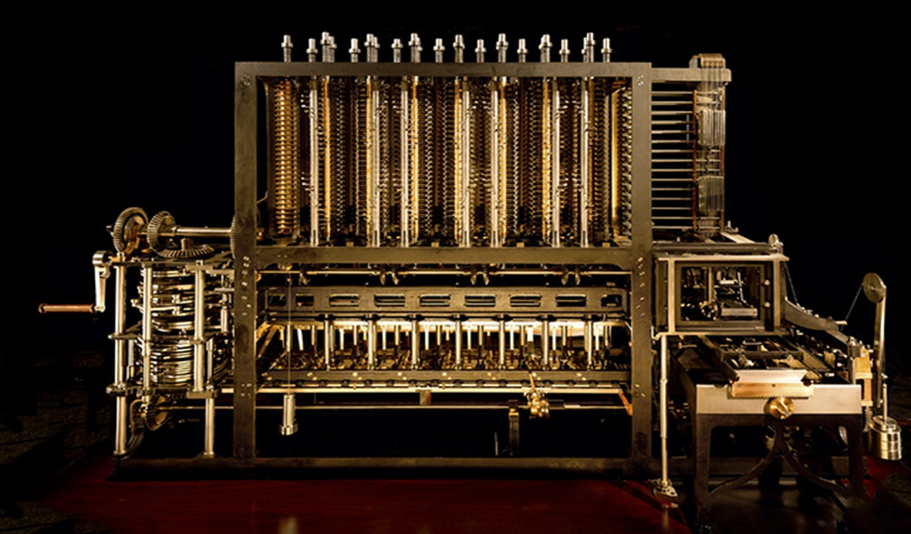
Babbage’s Difference Engine (1823)
He was a mathematician, philosopher and a mechanical engineer
He is best remembered now for originating the concept of a programmable computer
He is credited with inventing the first mechanical computer (So considered as father of computer)

Slide 17
ENIAC (1943 -1946)
ENIAC (Electronic Numeric Integrator And Computer)
Designed by Mauchly and Eckert (University of Pennsylvaniya)
First general purpose electronic computer
Response to WW2 need to calculate trajectory tables for weapons
ENIAC details in decimal (not binary)
20 accumulators for 10 digits
Programmed manually by switches
18,000 vacuum tubes, 30 tons
15,000 sft, 140 KW power consumption
5000 additions per second

Slide 18
ENIAC (1943 -1946)
Vacuum tubes

Slide 19
ENIAC (1943 -1946)
To reprogram the ENIAC you had to rearrange the patch cards that you can observe on the left in the photo, and the setting of 3000 switches that you can observe on the right

Slide 20
Transistor Based Computers
Transistors replaced vacuum tubes
Smaller, cheaper and less heat dissipation
Made from silicon (sand)
Invented at Bell labs, 1947
Commercial Transistor based computers: NCR & RCA produced small transistor machines, IBM 7000, DEC – 1957 (PDP -1)

Slide 21
Transistor Based Computers
First transistor based computer – Manchester University (1953)

Slide 22
Integrated Circuits
A single self contained transistor is called a discrete component
Transistor based computers – discrete components manufactured separately, packed in their own containers, and soldered or wired together onto circuit boards
The transistor based computers contained about 10000 transistors – but grew up to hundreds of thousands
Integrated circuits revolutionized electronics
Silicon chip - collection of tiny transistors

Slide 23
Generation of computers
Vacuum tubes – 1946 – 1957 (one bit – size of hand)
Transistors - 1958 -1964 (one bit – size of a finger nail)
Small Scale Integration (SSI) – 1965 onwards (up to 100 of devices on a single chip)
Medium Scale Integration (MSI) –up to 1971 (100 to 3000 devices on chip
Large Scale Integration (LSI) – 1971 -1977 (3000 to 100,000 devices on a chip
Very Large Scale Integration (VLSI) – 1978 – Till date (100,000 to 100,000,000 devices on a chip
Ultra Large Scale Integration (ULSI) (over 100,000,000 devices on a chip

Slide 24
Computer Generations
Generation | Period | Technology
First | 1945 - 1954 | Vacuum Tubes
Second | 1955 - 1964 | Transistors
Third | 1965 -1974 | Integrated Circuits (SSI, MSI)
Fourth | 1975 - ? | Integrated Circuits (LSI, VLSI)
FIFTH | ? | AI, Neural Network, Web Computing etc.

Slide 25
Registers
To speed up the processor operations, the processor includes some internal memory storage locations called registers
Memory hierarchy
Registers
Cache memory
Main memory
Secondary memory
At higher level of hierarchy, memory is faster, smaller and more expensive
Registers top level of hierarchy
Two roles
User visible registers – referenced by machine instruction
Control and Status registers – employed to control the operation

Slide 26
User visible registers
General purpose register
Data registers
Address registers
Condition code registers

Slide 27
User visible registers
General-purpose register (R₀ – R_{n-1})
Data register – used only to hold data and not for any other
purpose
Address Register
Segment register – holds the address of the base of the segment
Index register – Used for indexed addressing
Stack Pointers – points to the top of the stack
Condition Codes (Flags) – are bits set by the processor as a
result of an operation

Slide 28
Control and Status registers
Not visible under user mode
Instruction Register (IR) – used to store the instructions
Program Counter (PC) – gives the address of next instruction to be executed
Memory address register (MAR) – holds the address of the memory to
read/write data
Memory data register (MDR) – holds the data/instruction fetched from the
memory

Slide 29
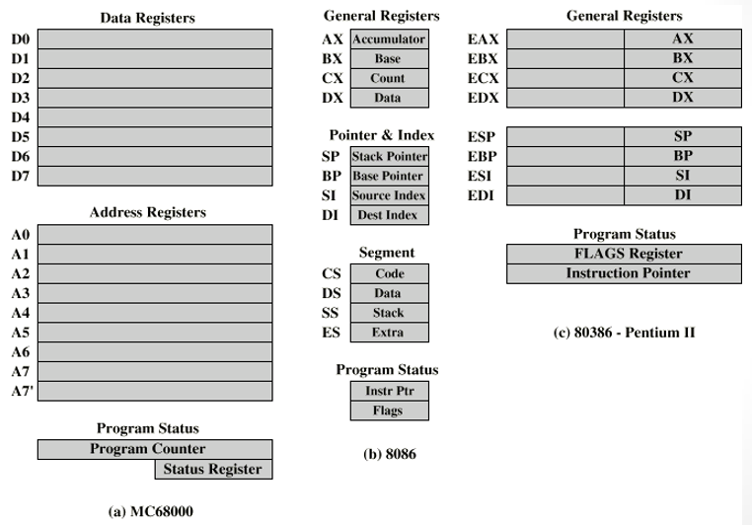
Examples of Register Organization

Slide 30
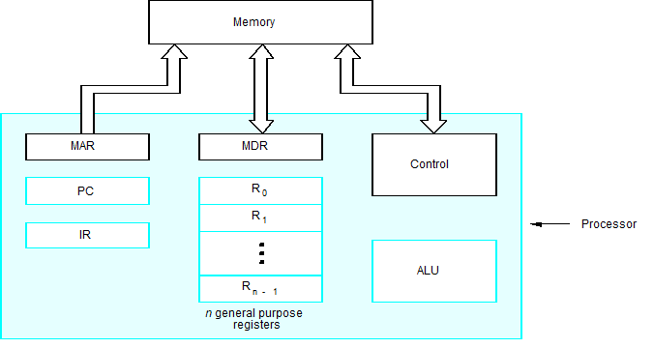
Connection Between the Processor and the Memory

Slide 31
Register Files
The register file is the component that contains all the general purpose registers of the microprocessor.
It is an array of processor register in a CPU
It can be implemented using SRAM with multiple ports
SRAMs are distinguished by having dedicated read and write ports, whereas ordinary multiported SRAMs will usually read and write through the same ports.

Slide 32
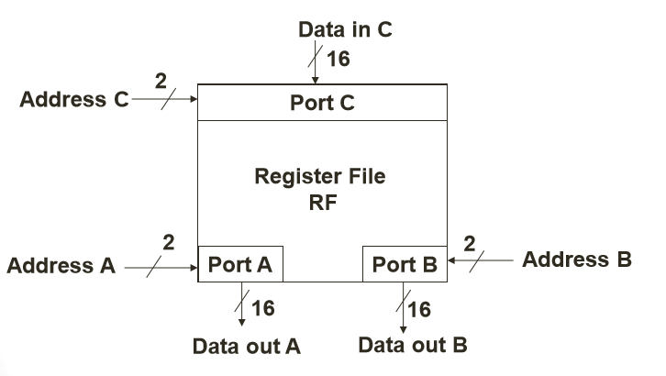
Register Files
A simple register file is a set of registers and a decoder. The register file requires an address and a data input
To read two values at once and write one value back in a single cycle. Consider the following equation: C = A + B

Slide 33
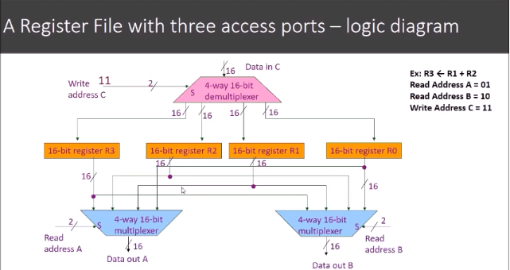

Slide 34
Interconnection of Components
Functional components of the computer needs to be interconnected
A group of lines/wires that serves as a connecting path for several devices is called a Bus
The collection of paths connecting the various modules is called the interconnection structure
Bus that connects the major components are called System Bus
Bus is a shared transmission medium

Slide 35
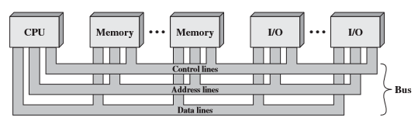
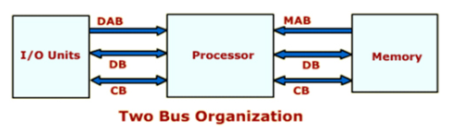
Bus Structures

Slide 36
Speed Issue
Different devices have different transfer/operate speed.
If the speed of bus is bounded by the slowest device connected to it, the efficiency will be very low.
How to solve this?
A common approach – use buffers.

Slide 37
Computer Architecture
Broadly can be classified into two types
Von Neumann architecture
Harvard architecture

Slide 38
Von Neumann Architecture
The stored program concept is given by a mathematician Von
Neumann
In 1946, Von Neumann and his colleagues began the design of a new stored program computer, referred as IAS computer at the Princeton Institute for Advanced Studies
General structure of IAS computer
Instructions and data are stored in the same memory module
More flexible and easier to implement
Suitable for most of the general purpose processors
Disadvantage: All instructions and data are moved back and forth through the same pipe

Slide 39
Structure of Von Neumann Machine

Slide 41
IAS Memory Format

Slide 42
IAS Memory Format
1000 x 40 bit words (1000 storage locations of 40 binary bits each)
- Both instructions and data stored here
Number format
- Each number is represented by a sign bit and a 39 bit value
Instruction format
- A word may contain two 20 bit instructions
- 8 bit operation code (opcode) : specifying the operation to be
performed and
- 12 bit address : designating one of the word in memory (0 to 999)

Slide 43
Harvard Architecture

Slide 44
Harvard Architecture
The Harvard architecture is a computer architecture with physically separate memory
Separate memory for program and data
Instruction are stored in program memory
Data stored in data memory
In Harvard architecture, there is no need to make the two memories shared characteristics
In particular, word width and memory address structure can differ
In some systems, instructions can be stored in read-only memory whereas the data stored in read-write memory
In some systems, there is much more instruction memory than data memory so instruction addresses is wider than data addresses

Slide 45
Von Neumann vs Harvard architecture

Slide 46
Pipeline in Executing Instructions
Pipeline is the concept to speedup the execution
Pipeline means overlap execution
Instruction execution is typically divided into 5 stages
- Instruction Fetch (IF)
- Instruction Decode (ID)
- ALU operation (EX)
- Memory Access (MEM)
- Write Back result to register file (WB)
These five stages can be executed in an overlapped fashion in pipeline architecture

Slide 47
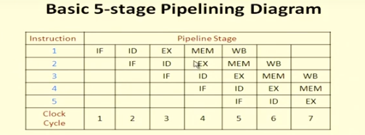

Slide 48
Performance
The most important measure of a computer is how quickly it can execute programs.
Three factors affect performance:
Hardware design
Instruction set
Compiler

Slide 49
Performance
Processor time to execute a program depends on the hardware involved in the execution of individual machine instructions.
The processor and a relatively small cache memory can be fabricated on a single integrated circuit chip.
Speed
The internal speed of performing the basic steps of instruction processing on cache is very high
Cost
Memory management

Slide 50
Processor Clock
Clock, clock cycle, and clock rate
Processor circuits are controlled by a timing signal called Clock
The clock defines regular time intervals called clock cycles
To execute a machine instruction, the processor divides the action to be performed into sequence of basic steps such that each step can be completed in one clock cycle
Let P be the length of one clock cycle. Its inverse R=1/P is called clock rate, which is measured in cycles per second.

Slide 51
Basic Performance Equation
T – processor time required to execute a program that has been prepared in high-level language
N – number of actual machine language instructions needed to complete the execution (note: loop)
S – average number of basic steps needed to execute one machine instruction. Each step completes in one clock cycle
R – clock rate
How to improve T?

Slide 52
Instructions are not necessarily executed one after another.
The value of S doesn’t have to be the number of clock cycles to execute one instruction.
Pipelining – overlapping the execution of successive instructions.
Add R1, R2, R3
Superscalar operation – multiple instruction pipelines are implemented in the processor.
Goal – reduce S (could become <1!)

Slide 53
Clock Rate
Increase clock rate
Improve the integrated-circuit (IC) technology to make the circuits faster
Reduce the amount of processing done in one basic step (however, this may increase the number of basic steps needed)
Increases in R that are entirely caused by improvements in IC technology affect all aspects of the processor’s operation equally except the time to access the main memory.

Slide 54
Compiler
A compiler translates a high-level language program into a sequence of machine instructions.
To reduce N, we need a suitable machine instruction set and a compiler that makes good use of it.
Goal – reduce N×S
A compiler may not be designed for a specific processor; however, a high-quality compiler is usually designed for, and with, a specific processor.

Slide 55
Performance Measurement
T is difficult to compute.
Measure computer performance using benchmark programs.
System Performance Evaluation Corporation (SPEC) selects and publishes representative application programs for different application domains, together with test results for many commercially available computers.
Compile and run (no simulation)
Reference computer

